Slide 1
Chapter 8 Solution Chemistry–How Sweet Is Your Coffee?
Types of solutions
Solubility
Electrolytes
Units of Concentration
Dilution
Osmosis
Transport across cell membrane

Slide 2
Types of Solution
Solution – homogeneous mixture of two or more substances of ions or molecules. E.g. NaCl (aq)
Solvent = component which is the component in greater amount.
Solute = component which is present in the smaller amount.
Gaseous = gases are completely miscible in each other.
Liquid = gas, liquid or solid solute dissolved in solute.
Solid = mixture of two solids that are miscible in each other to form a single phase.

Slide 4
Types of Solution
Colloid – appears to be a homogeneous mixture, but particles are much bigger, but not filterable. E.g. Fog, smoke, whipped cream, mayonnaise, etc.
Suspension: larger particle sizes, filterable. E.g. mud, freshly squeezed orange juice.
Solubility and the Solution Process

Slide 5
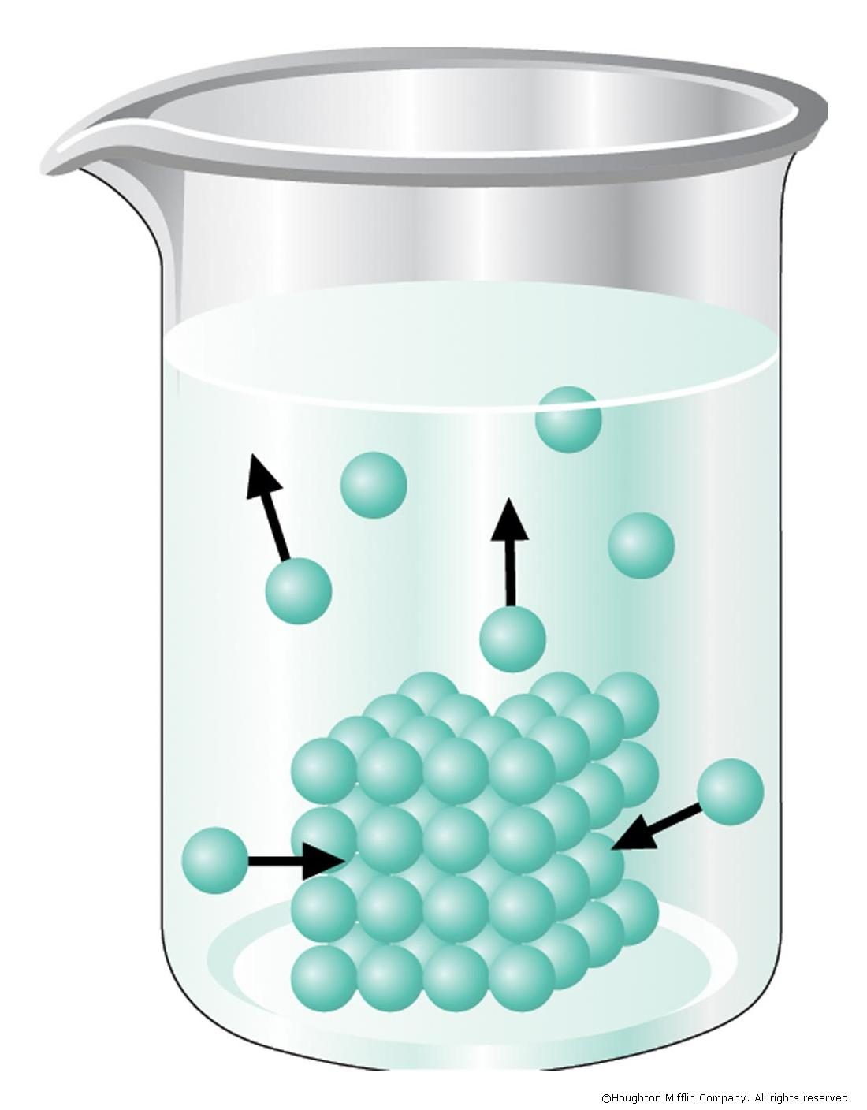
Solubility and the Solution Process
The solid dissolves rapidly at first but as the solution approaches saturation the net rate of dissolution decreases since the process is in dynamic equilibrium.
When the solution has reached equilibrium the amount of solute does not change with time;
At equilibrium: the rate of dissolution = rate of solution
Solubility Equilibrium

Slide 6
Solubility and the Solution Process
Saturated solution: maximum amount of solute is dissolved in solvent. Trying to dissolve more results in undissolved solute in container.
Solubility: Amount of solute that dissolves in a solvent to produce a saturated solution. (Solubility often expressed in g/100 mL.)
E.g. 0.30 g of I₂ dissolved in 1000 g of H₂O.
Unsaturated solution: less than max. amount of solute is dissolved in solvent.
E.g. 0.20 g of I₂ dissolved in 1000 g of H₂O.
Supersaturation = more solute in solution than normally allowed; we call this a supersaturated solution.

Slide 7
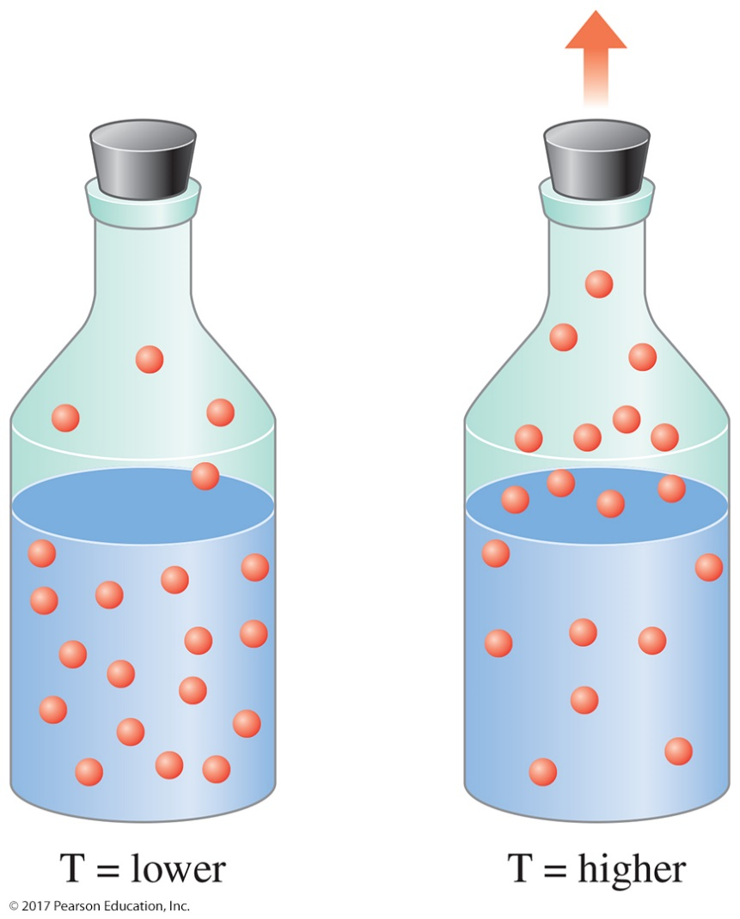
Solubility and Temperature
The solubility of most solids dissolved in water increases with temperature.
Solubility can be manipulated by changing the temperature of a solution.
The solubility of a gas dissolved in water decreases with a rise in temperature.

Slide 8
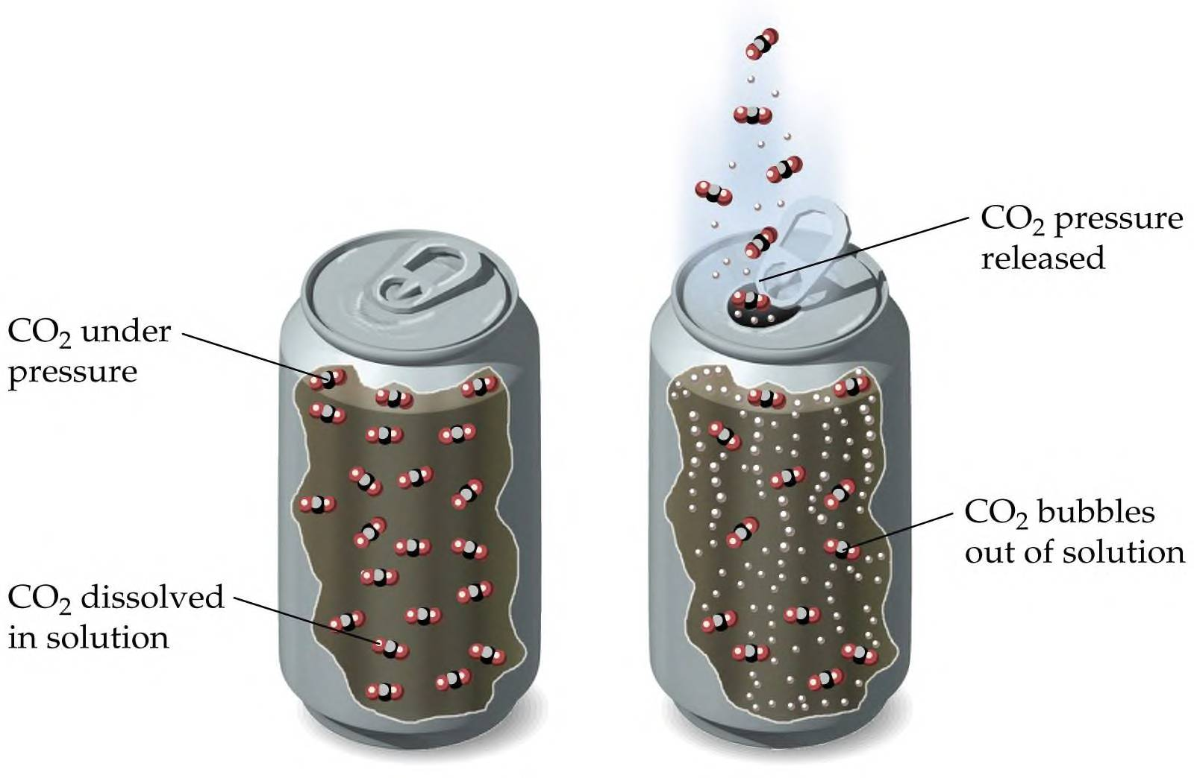
Solubility and Pressure—Henry’s Law
Henry’s law: The solubility of a gas in a liquid is directly related to the pressure of that gas over the liquid.

Slide 9
If the pressure of CO₂ is higher in the blood delivered back to the lungs (coming from the tissues) than the pressure of CO₂ found at the lungs, the gaseous CO₂ will pass out of the bloodstream into the lungs.
Similarly, oxygen dissolves into the blood at the lungs because the pressure of oxygen in the air is higher, allowing it to dissolve in the bloodstream.

Slide 10
Electrolytes and Nonelectrolytes
Electrolyte: substance that dissolved in water produces a solution that conducts electricity
Contains ions
Nonelectrolyte: substance that dissolved in water produces a solution that does not conduct electricity
Does not contain ions

Slide 11
Dissociation - ionic compounds separate into constituent ions when dissolved in solution
Ionization - formation of ions by molecular compounds when dissolved

Slide 12
Strong and weak electrolytes
Strong Electrolyte: 100% dissociation
All water soluble ionic compounds, strong acids and strong bases
Weak electrolytes
Partially ionized in solution
Exist mostly as the molecular form in solution
Weak acids and weak bases

Slide 13
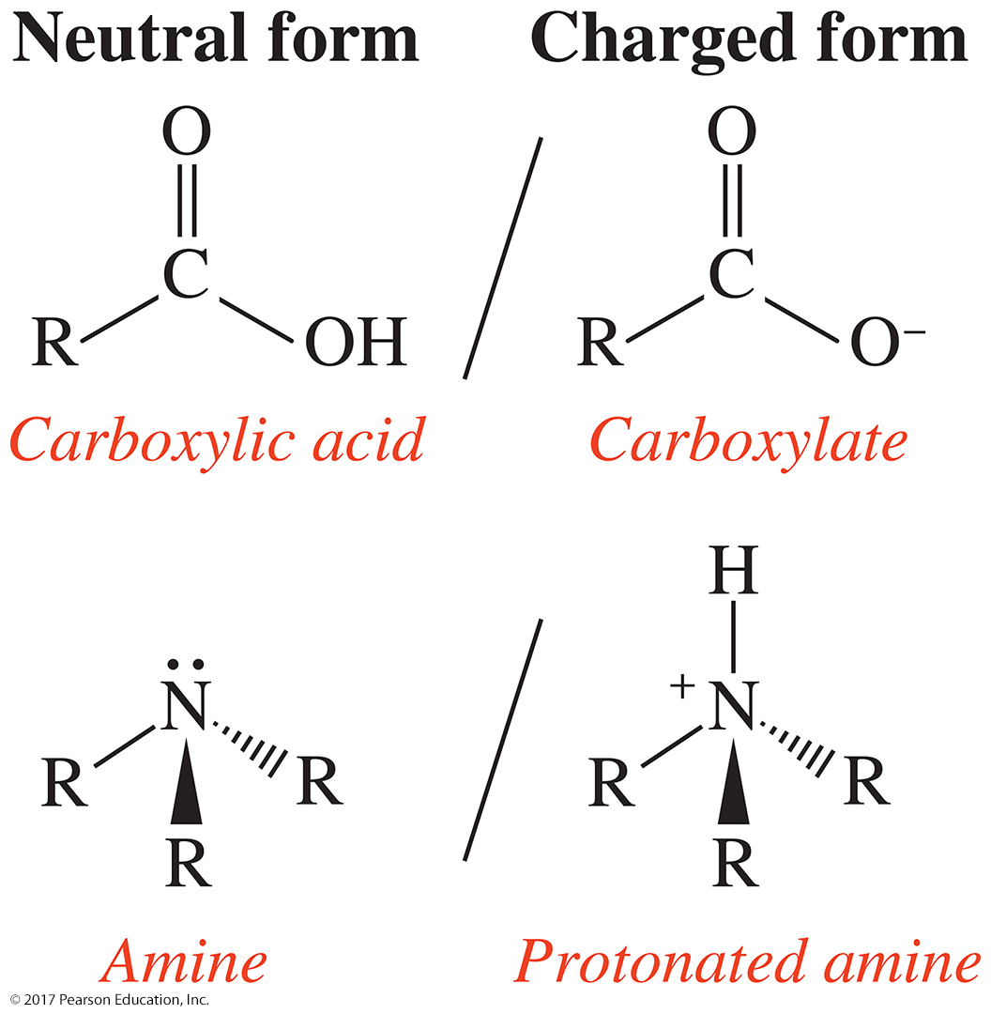
Weak Electrolytes
There are two functional groups that contain a form with an ionic charge, the carboxylic acid/carboxylate group and the amine/protonated amine.
Carboxylic acids and amines are weak electrolytes.

Slide 14
Classify the following as nonelectrolyte,weak electrolyte or strong electrolyte
NaOH
CH₃OH
H₂CO₃

Slide 15
Equivalents
An equivalent (Eq) is the amount of an electrolyte or an ion that provides 1 mole of electrical charge (+ or -).
1 mole Na⁺ = 1 equivalent
1 mole Cl⁻ = 1 equivalent
1 mole Ca²⁺ = 2 equivalents
1 mole Fe³⁺ = 3 equivalents

Slide 16
Electrolytes in Body Fluids
In replacement solutions for body fluids, the electrolytes are given in milliequivalents per liter (mEq/L).
Ringer’s Solution
Na⁺ 147 mEq/L Cl⁻ 155 mEq/L
K⁺ 4 mEq/L
Ca²⁺ 4 mEq/L
The milliequivalents per liter of cations must equal the milliequivalents per liter of anions.

Slide 17
Concentration
Millimoles per Liter (mmol/L) and Molarity (M)
Sometimes the units for electrolytes are given in mmoles/L instead of mEq/L.
The charge on an ion is the number of equivalents present in 1 mole.
For an ion with a +1 charge, the units mEq/L and mmole/L are the same.
A related unit is molarity (M), which is defined as
Other common rearrangements:

Slide 18
Practice
A pot of chai tea has a volume of 600. mL, a mass of 618. g, and contains 866 mg of cinnamonaldehyde (C₉H₈O), the principle component of cinnamon. What is the molarity of cinnamonaldehyde in the tea?

Slide 19
Percent Concentration
The concentration of a solution is the amount of solute dissolved in a specific amount of solution.
amount of solute
amount of solution
Mass percent (%m/m) is the
concentration is the percent by mass of solute in a solution.
mass percent = g of solute x 100
g of solute + g of solvent
Mass of solute + mass of solvent = mass of solution.

Slide 20
Volume Percent
The volume percent (%v/v) is
percent volume (mL) of solute (liquid) to volume (mL) of solution.
volume % (v/v) = mL of solute x 100
mL of solution
The mass/volume percent (%m/v) is
percent mass (g) of solute to volume (mL) of solution.
mass/volume % (m/v) = g of solute x 100
mL of solution

Slide 21
Parts per Million (ppm) and Parts per Billion (ppb): When concentrations are very small, as often occurs in dealing with trace amount of pollutants or contaminants, parts per million (ppm) or parts per billion (ppb) units are used.

Slide 22
Practice
A solution is prepared by mixing 15.0 g Na₂CO₃ and 235 g of H₂O. Calculate the mass percent (%m/m) of the solution.
Write two conversion factors for each solutions.
A. 8.50% (m/m) NaOH
B. 5.75% (v/v) ethanol
C. 4.8% (m/v) HCl
How many milliliters of a 5.75% (v/v) ethanol solution can be prepared from 2.25 mL ethanol?

Slide 23
Dilution
Dilution is the process of decreasing the concentration of a stock solution by adding more solvent to the solution. The solvent added is usually the universal solvent, known as water. The more solvent you add, the more diluted the solution will get.
Dilution Equation
C_{initial} represents the initial concentration, C_{final} represents the final concentration,
V_{initial} represents the initial volume, and V_{final} represents the final volume.
If three of the variables are known, the fourth can be determined.

Slide 24
Practice
A stock solution of 1.00M of NaCl is available. How many milliliters are needed to make a 100.0 mL of 0.750M?
Concentrated HCl is 12M. What volume is needed to make 2L of a 1M solution?

Slide 25
Dilution Factor
The DILUTION FACTOR is how many times less concentrated is a new solution.
First concentration
Second Concentration
=
Dilution Factor
C1/C2 = Dilution Factor
The use of concentrated stock solutions is common practice for storage of medications in the pharmacy.

Slide 26
Osmosis and Osmotic Pressure
Osmosis: is the diffusion of water across a membrane. Like other molecules, water will move from an area of high concentration to an area of low concentration. The more solute there is in a solution, the lower the concentration of water in that solution.
Osmotic pressure: The amount of external pressure applied to the more concentrated solution to halt the passage of solvent molecules across a semipermeable membrane.
equal to the pressure that would prevent the flow of additional water into the more concentrated solution

Slide 27
Practice
A 10M solution has been diluted to 2M solution what is the dilution factor?
You do a dilution by combining 100 ml of 1M MgCl₂ plus 700 ml unit volumes of RO water. What is the dilution factor, i.e, how many more times dilute is it than the original concentration?

Slide 28
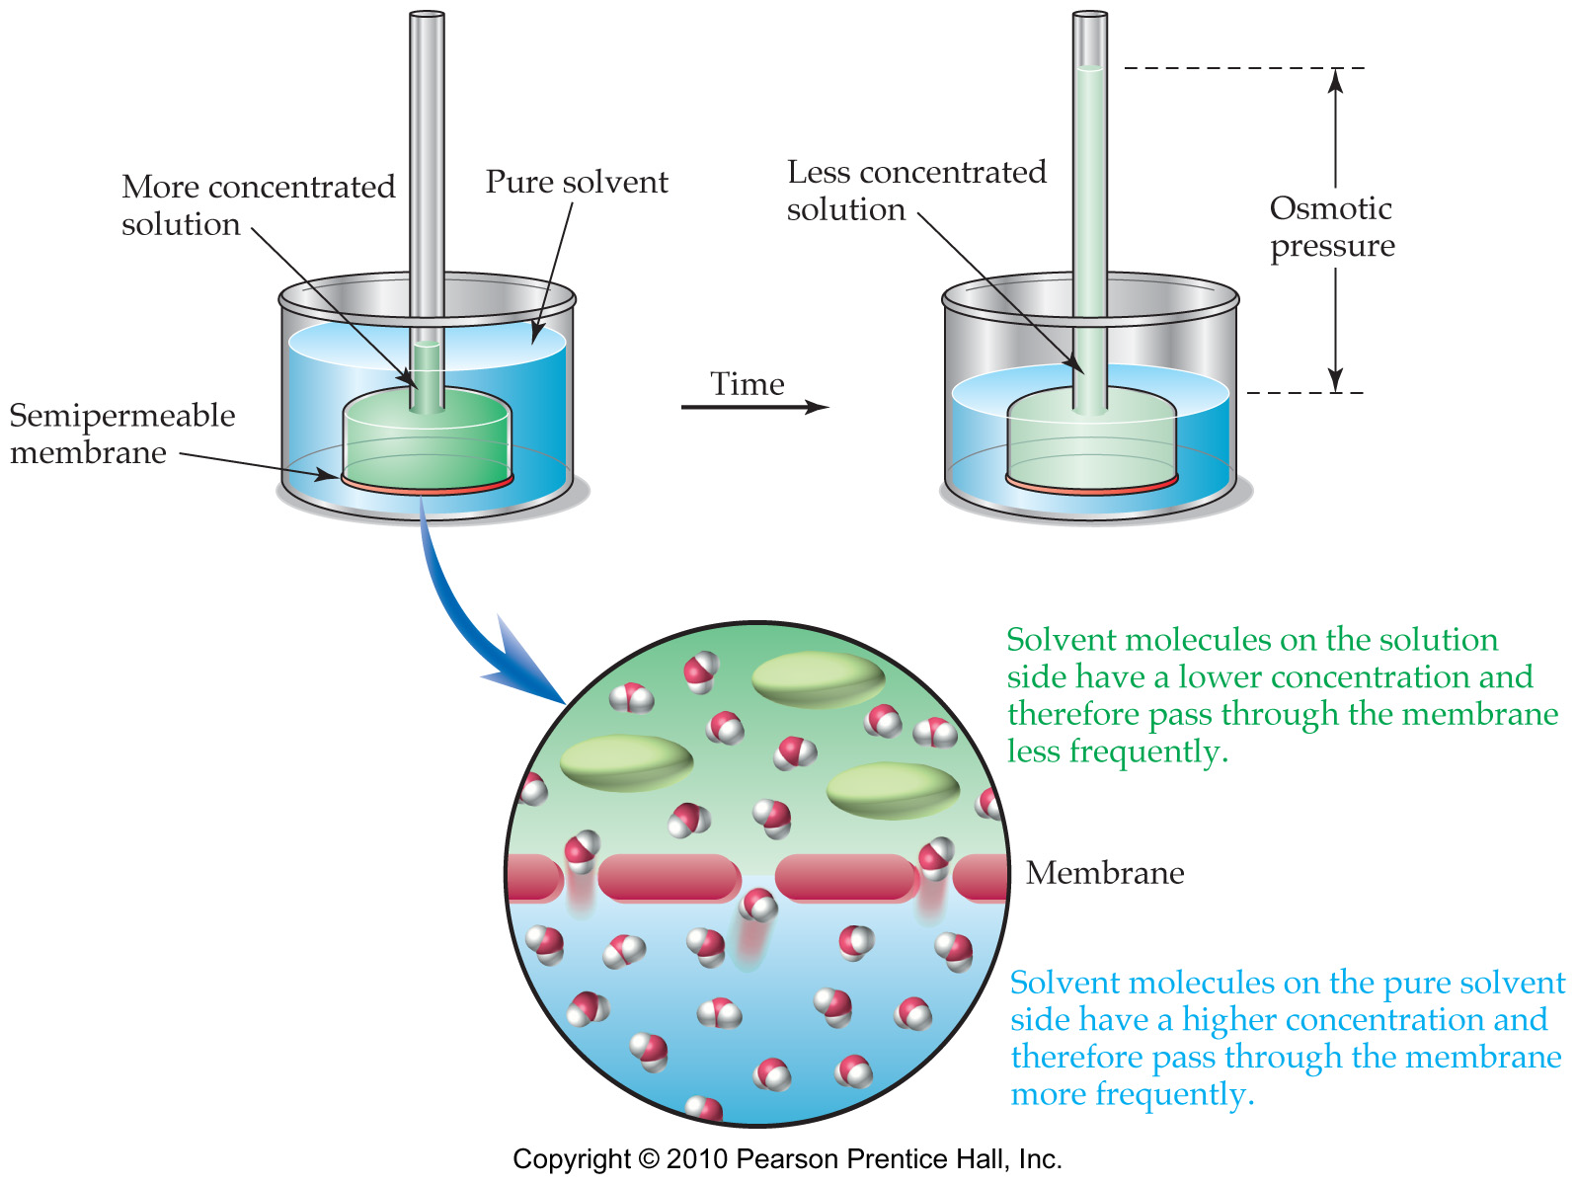

Slide 29
Isotonic: Isotonic environments have the same concentration of solute as the cell. Water will diffuse both in and out of the cell, but no net effect will be seen.
Hypotonic: Hypotonic environments will have a lower concentration of solute than the cell. Water will move from the environment into the cell in order to balance the concentration of solute. When water diffuses into the cell it will swell. Sometimes the cell may lyse or burst due to the excess water uptake.
Hypertonic Hypertonic solutions will have a higher concentration of solute (glucose, salt, etc) than the cell. Mainly water will move across the cell membrane in order to even out the concentration of solutes in both the cell and the environment around the cell. The cell will shrink as water leaves the cell to decrease the higher concentration of solute in the environment.

Slide 30
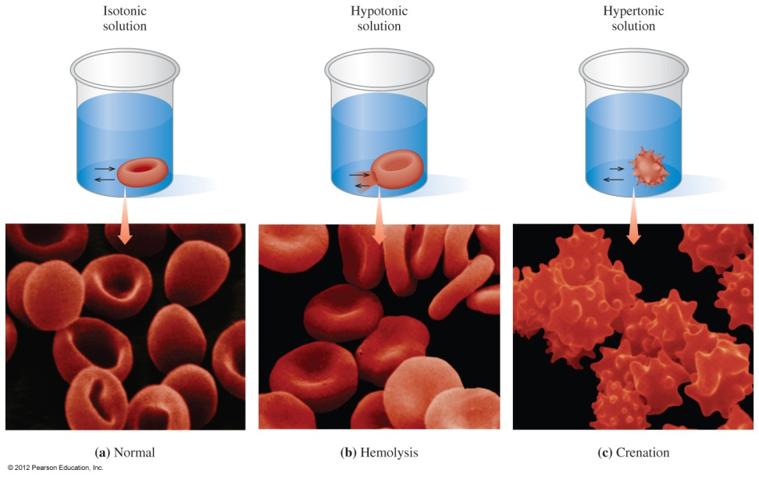
Dialysis
In dialysis,
solvent and small solute particles pass through an artificial membrane
large particles are retained inside
waste particles such as urea from blood are removed using hemodialysis (artificial kidney)
(a) In an isotonic solution, a red blood cell retains its normal volume. (b) Hemolysis: In a hypotonic solution, water flows into a red blood cell, causing it to swell and burst. (c) Crenation: In a hypertonic solution, water leaves the red blood cell, causing it to shrink.

Slide 31
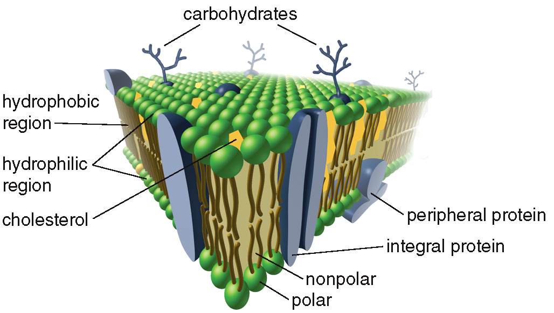
Cell Membrane
- Peripheral proteins are embedded within the membrane and extend outward on one side only.
- Integral proteins extend through the entire bilayer.
- Sometimes carbohydrates are attached to the exterior of the cell forming glycolipids and glycoproteins.

Slide 32
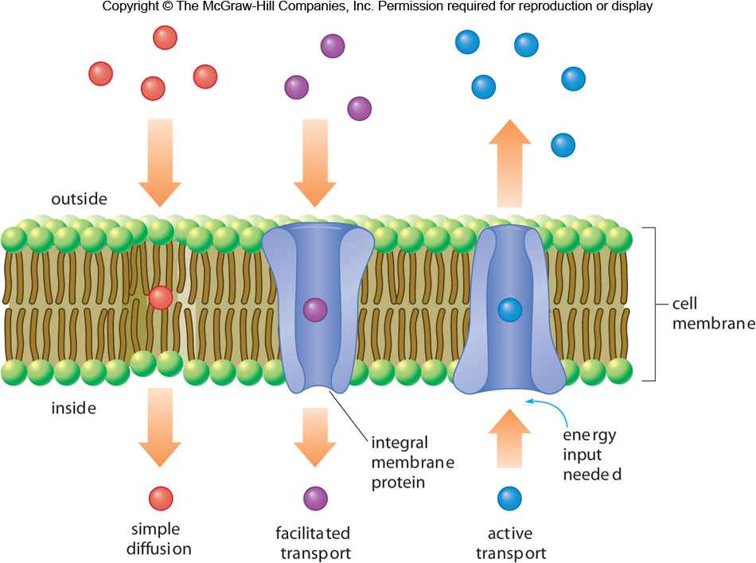
Transport Across a Cell Membrane
Simple Diffusion: Small molecules like O₂ and CO₂ can diffuse through the cell membrane, traveling from higher to lower concentration.
Facilitated Transport: Larger polar molecules (glucose) and ions (Cl⁻ and HCO₃⁻) travel through integral protein channels.
Active Transport: Other ions, Na⁺, K⁺, and Ca²⁺, move against the concentration gradient; this required energy input.

